Slide 1



Sprint III
Stock Ticker Project
Team Wasserfall
Project Manager: Erin Sauter
Scrum Master: Zhengqi Yang
Team Memebrs: Qiuda Lyu, Isaiah Lloyd

Slide 2



Accomplishments
Connected JPanels using CardLayout
Created a Brand New Portfolio Page
Portfolio Page showcasing a watchlist and an Overview

Slide 3
01
Part 1
CardLayout
Special Thanks to Caitlyn

Slide 4
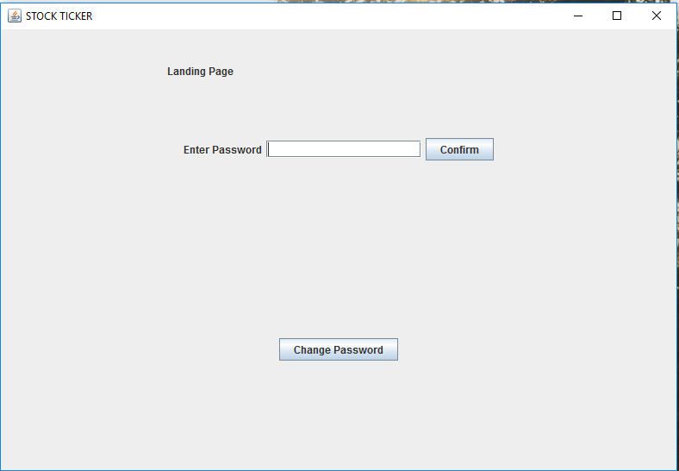
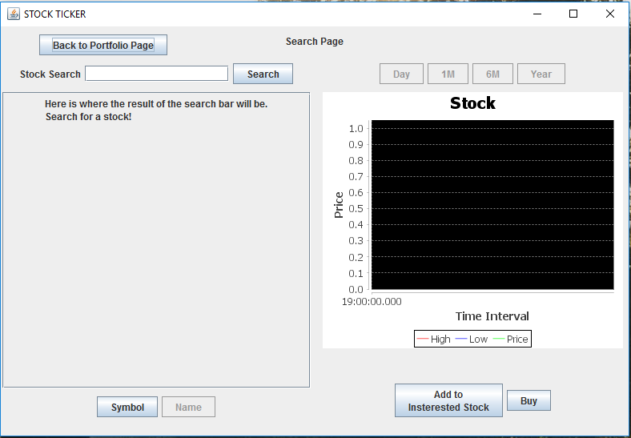


1
So far, we have three different JPanels for three main categories of functionalities:
1) Landing Page
2) Search Page
3) Portfolio Page
Now, we have managed to connect all three Panels using CardLayout and corresponding JButtons.

Slide 5
02
Part 2
Portfolio Page

Slide 6
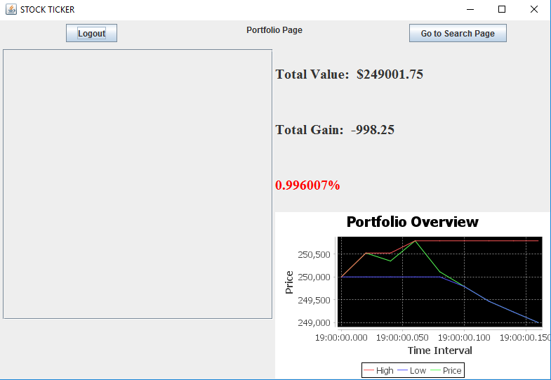
2
Frame design
two main part in the Frame
leftPart & rightPart as GrideLayout (1,2)
Left Part
make it as BorderLayout, add a JScrollPane in CENTER
Right Part
make it as GrideLayout(2,1)
There are three JPanel in the top JPanel
Bottom JPanel is for Portfolio Overview gragh

Slide 7
03
Part 3
Watchlist,
Storage,
Dynamic Display

Slide 8
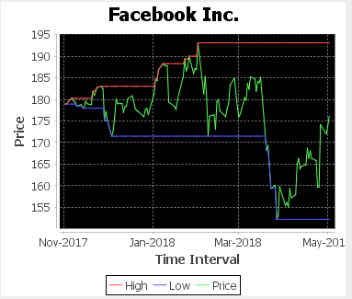
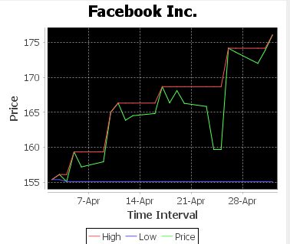
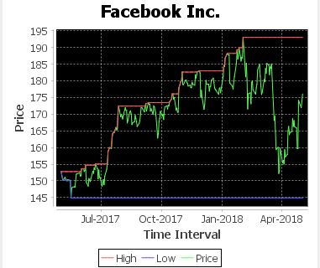
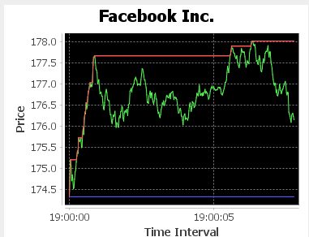
3
M3
M1
Y1
D

Slide 9
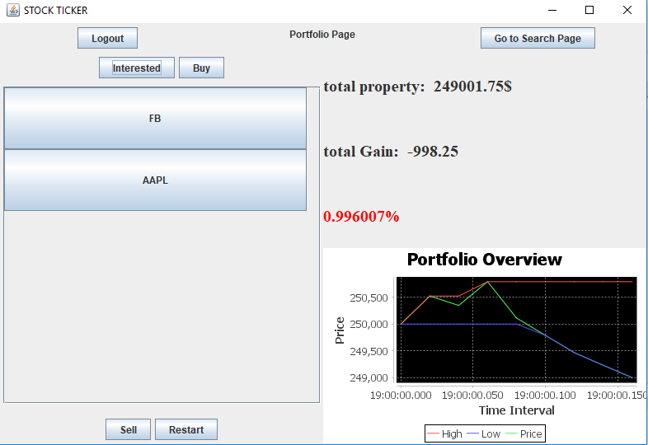
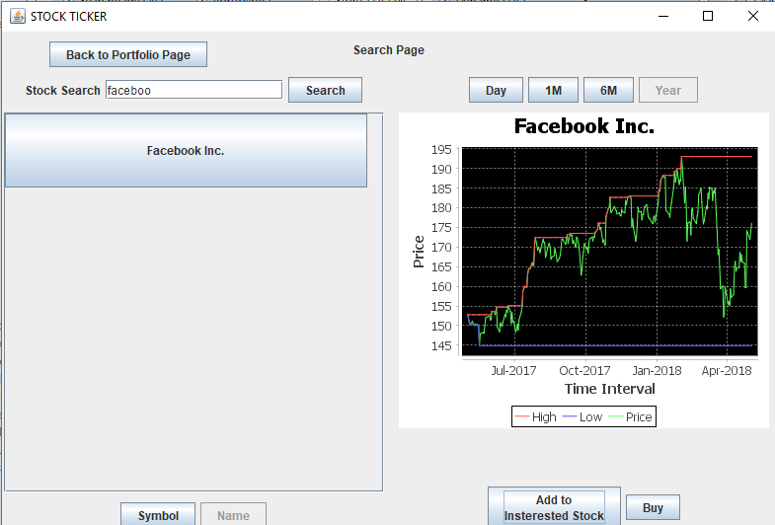
3
WatchList

Slide 10
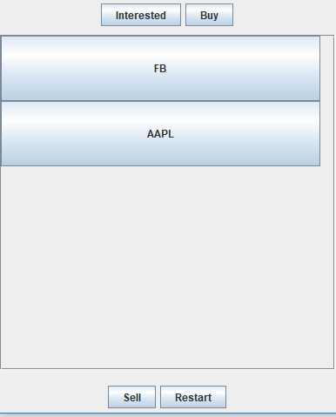
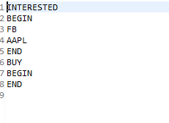
Storage

Slide 11
04
Part 4
Record System

Slide 12
Backend Programming
4
Purpose: Maintaining lists of easily accessible information
Designed to implemement broad spanning calculations and functions
Upper limit of 150 Stocks
Intended to expand to fit further functionalities as needed.

Slide 13

Thank You for Listening!
Full Demo

